Slide 1
Operating Systems Tutorial
Amit Dua
Computer Science and Information Systems Department
BITS, Pilani

Slide 2
Process File System
Tutorial 8
Slides taken from the ones prepared by Dr. Mayuri Digalwar

Slide 3
Today’s Agenda
Unix System Calls
Process Creation
Process Execution

Slide 4
Process
Process is an instance of executing program
• Main function of process is to Execute
Instruction residing in main memory
• Process is characterized by
– Its code, Data, stack and set of register
• During its life time, it can be in different states
such as running , not running

Slide 5
The Process
Includes
The program code, also called text section
Current activity including value of program counter and processor registers
Stack containing temporary data
Function parameters, return addresses, local variables
Data section containing global variables
Heap containing memory dynamically allocated during run time

Slide 6
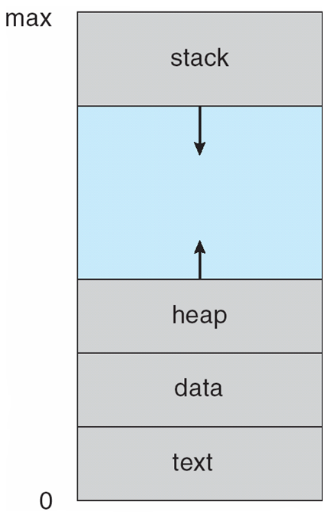
Process in Memory

Slide 7
Process Creation
Parent process create children processes, which, in turn create other processes, forming a tree of processes
Generally, process identified and managed via a process identifier (pid)
Resource sharing
Parent and children share all resources
Children share subset of parent’s resources
Execution
Parent and children execute concurrently
Parent waits until children terminate

Slide 8
Process Creation (Cont.)
Address space
Child process is duplicate of parent process
Child process has a program loaded into it
UNIX examples
fork system call creates new process
exec system call used after a fork to replace the process’ memory space with a new program

Slide 9
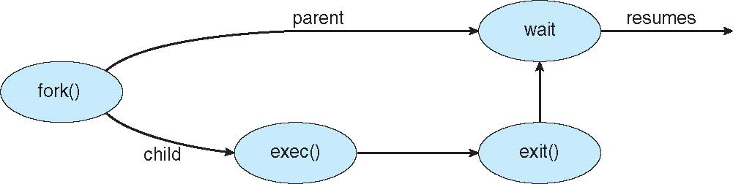
Process Creation

Slide 10
C Program Forking Separate Process
#include <sys/types.h>
#include <studio.h>
#include <unistd.h>
int main()
{
pid_t pid;
/* fork another process */
pid = fork();
if (pid < 0) { /* error occurred */
fprintf(stderr, "Fork Failed");
return 1;
}
else if (pid == 0) { /* child process */
execlp("/bin/ls", "ls", NULL);
}
else { /* parent process */
/* parent will wait for the child */
wait (NULL);
printf ("Child Complete");
}
return 0;
}

Slide 11
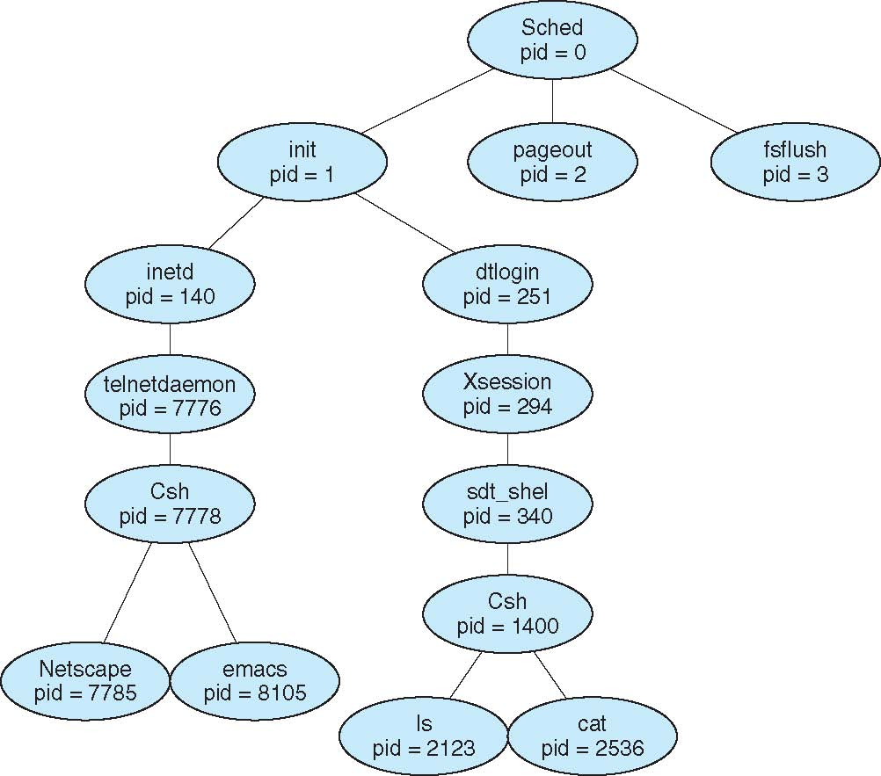
A Tree of Processes on Solaris

Slide 12
getpid() & getppid() system calls In Unix
To obtain current process id, use getpid() system call.
To obtain parent process id, use getppid() system call.
Notes:
12

Slide 13
#include <stdio.h>
#include <unistd.h>
#include<sys/types.h>
int main() {
printf("I am process %ld\n",(long)getpid());
printf("My Parent is %ld\n",(long)getppid());
}
output
mayuri@mayuri-Latitude-E5450:~$ ./a.out
I am process 3193
My Parent is 2981
Notes:
13

Slide 14
Fork() and exec() system calls
Fork()
It creates a new process which is an identical copy of an existing process.
The newly created process will contain all the instructions and data of its parent process.
Hence it executes the same parent process.
Exec()
This on the other hand re-initializes the existing process with some other designated program.
It does not create a new process.
It merely flushes the current context of a program and loads a new context (new program).
exec() call is the only way to execute programs in UNIX. In fact, the kernel boots itself using the exec() call.
fork() is the only way to create new processes in UNIX
Notes:
14

Slide 15
fork() system call
fork() call creates a “new” process.
The child process’ context will be the same as the parent process.
After a fork() call, two copies of the same context exist, one belonging to the child and another to the parent.
Contrast this to exec(), where a single context will exist because of child context over-writing the parent.
# include<unistd.h>
int fork(void);
/*Returns child process-ID and 0 on success and -1 on error */

Slide 16
Return value of fork() system call
After fork() returns
The child receives a 0 as return value from fork() and the parent receives the process-ID of the child.

Slide 17
What do parent and child share after fork
Scheduling priorities
Access rights to open files
Access to files
How is fork different to dup system call
What if ancestor has changed the root
What about the text, data and user stack regions
What is different then??

Slide 18
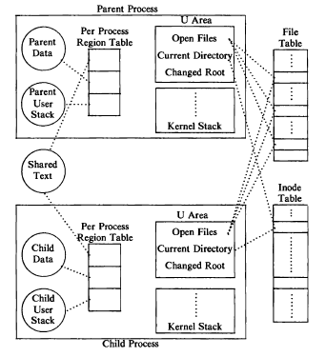

Slide 19
Program to demonstrate simple fork() usage
1# include<stdio.h>
2int main(void){
3 printf(“************ Before Fork************\n”);
4 system(“ps”);
5
6 fork();
7
8 printf(“************ After Fork *************\n”;
9 system(“ps”);
10 return 0;
11}

Slide 20
output
************ Before Fork************
PID TTY TIME CMD
2967 pts/0 00:00:00 bash
2990 pts/0 00:00:00 a.out
2991 pts/0 00:00:00 ps
************ After Fork *************
************ After Fork *************
PID TTY TIME CMD
PID TTY TIME CMD
2967 pts/0 00:00:00 bash
2967 pts/0 00:00:00 bash
2990 pts/0 00:00:00 a.out
2990 pts/0 00:00:00 a.out
2992 pts/0 00:00:00 a.out
2992 pts/0 00:00:00 a.out
2993 pts/0 00:00:00 ps
2993 pts/0 00:00:00 ps
2994 pts/0 00:00:00 ps
2994 pts/0 00:00:00 ps

Slide 21
Modified code
1# include<stdio.h>
2int main(void){
3 int ret;
4 printf(“************ Before Fork************\n”);
5 system(“ps”);
6
7 ret=fork();
8 if(ret==0){
9 printf(“************ After Fork *************\n”;
10 system(“ps”);
11 }
12 else if(ret>0)
13 wait();
14 return 0;
15}

Slide 22
output
************ Before Fork************
PID TTY TIME CMD
2967 pts/0 00:00:00 bash
3005 pts/0 00:00:00 a.out
3006 pts/0 00:00:00 ps
************ After Fork *************
PID TTY TIME CMD
2967 pts/0 00:00:00 bash
3005 pts/0 00:00:00 a.out
3007 pts/0 00:00:00 a.out
3008 pts/0 00:00:00 ps

Slide 23
fork() example 2
int main(void) {
pid_t pid;
printf("************ Before Fork************\n");
system("ls -l");
pid = fork();
if(pid == 0){
printf("************ After Fork *************\n");
system("ps");
}
else if (pid > 0)
wait();
return 0; }

Slide 24
[Mayuri@localhost processes]$ ./a.out
************ Before Fork************
total 60
-rwxrwxr-x. 1 Mayuri Mayuri 6937 Sep 13 16:30 a.out
-rw-rw-r--. 1 Mayuri Mayuri 310 Sep 6 16:48 env.c
-rw-rw-r--. 1 Mayuri Mayuri 145 Sep 6 17:06 execL.c
-rw-rw-r--. 1 Mayuri Mayuri 219 Sep 13 15:50 execlp.c
-rw-rw-r--. 1 Mayuri Mayuri 219 Sep 5 15:41 pid_ppid.c
-rwxrwxr-x. 1 Mayuri Mayuri 6919 Sep 13 13:16 sum
-rw-rw-r--. 1 Mayuri Mayuri 280 Sep 13 13:16 sum.c
-rw-rw-r--. 1 Mayuri Mayuri 326 Sep 2 13:03 system1.c
************ After Fork *************
PID TTY TIME CMD
2806 pts/0 00:00:00 bash
3565 pts/0 00:00:00 a.out
3567 pts/0 00:00:00 a.out
3568 pts/0 00:00:00 ps

Slide 25
int main(int argc, char *argv[]){
int pid;
printf("*****before fork****\n ");
system("ps");
pid = fork();
if(pid == 0)
{
printf("*****after fork****\n ");
printf("child pid = %d\n",pid);
//execl("/bin/echo","echo","hello","world",(char *)NULL);
execlp("echo","echo","hello","world",(char *)NULL);
}
else {
printf("parent pid = %d\n",pid);
wait();
}
return 0; }

Slide 26
output
[Mayuri@localhost processes]$ ./a.out
*****before fork****
PID TTY TIME CMD
2806 pts/0 00:00:00 bash
4196 pts/0 00:00:00 a.out
4197 pts/0 00:00:00 ps
parent pid = 4198
*****after fork****
child pid = 0
hello world

Slide 27
Forking Cost
fork() calls are enormously costly in terms of computing resources.
A clone of the parent’s context is made which involves copying of the data segment.
Copy of instruction segment (code) is not made because the segment is read-only and hence is shared between parent and child.
The data segment can be very huge. if fork() is immediately followed by exec() then it overwrites the existing data and code segments. Hence copying data segment is wasted.
A scheme that overcomes this handicap is called the “copy-on-write” scheme.
In this scheme, after fork() the parent and the child share the same data segment as long as the data segment is unmodified. When the parent or child modifies a particular page, a copy of only that page is made. So, there would be two copies of modified pages while the unmodified pages would be shared.

Slide 28
Fork bombs
Repeated fork() calls (also known as fork bombs), can eventually lead to resource exhaustion and may collapse the system.
Program to demonstrate repeated forking
int main(void){
int cnt=0;
int pid;
for(cnt=0;cnt<3;cnt++){
pid=fork();
printf("Now in process %d\n",getpid());
}
return 0;
}
how many new processes would be created?

Slide 29
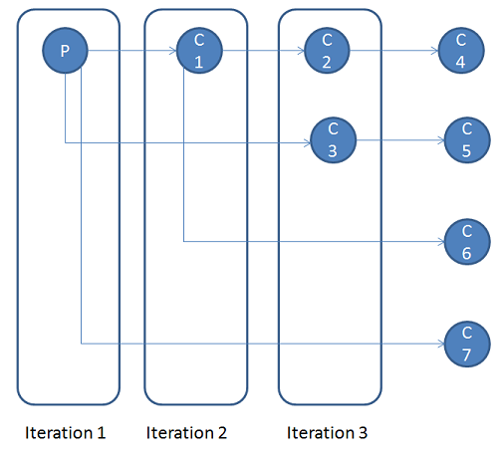
The number of children would be : 7
In the first iteration, only the parent process exists and it creates a single child, C1.
In the second iteration both P and C1 exist and each fork to give C3 and C2 respectively
In the last iteration P,C1,C2,C3 exist and each fork to give C7,C6,C4,C5 respectively.

Slide 30
Program to demonstrate controlled forking
int main(void){
int cnt=0; int pid;
for(cnt=0;cnt<3;cnt++){
pid=fork();
if(pid==0)
continue;
else
break;
}
printf("Process %d\n",getpid());
return 0;
}

Slide 31
Exec () System Call
Exec()
This on the other hand re-initializes the existing process with some other designated program.
It does not create a new process.
It merely flushes the current context of a program and loads a new context (new program).
exec() call is the only way to execute programs in UNIX. In fact, the kernel boots itself using the exec() call.
fork() is the only way to create new processes in UNIX

Slide 32
Exec Family
Exec system calls are a set six system call of the form execAB
execl
execv
execlp
execvp
execle
execve

Slide 33
execl() system Call
It execute file with arguments explicitly in call.
Syntax
int execl (
const char *path, /* Complete Program pathname */
const char *arg0, /* First Argument(filename) */
const char *arg1, /* Second Argument(optional) */
… /* Remaining Arguments (if any) */
(char *) NULL /* Arg list terminator */
);
/* Returns -1 on error (sets errno) */

Slide 34
execl() system call
After the call to execl() the context of the process is overwritten.
Previous code is replaced by the code/instructions of the executable in ‘path’.
User data is also replaced with the data of the program in ‘path’ thereby reinitializing the stack.
And the new program begins to execute from its main function.
New program accesses the arguments of new program which are mentioned in execl() through its ‘argc’ and ‘argv’ arguments of the main function.
Environment pointed to by ‘environ’ is also passed to the new program.

Slide 35
Return of execl() system call
Recall that the return address of any function is saved in the stack.
The return address is popped from the stack while a function returns.
But here the stack is reinitialized with the data of the new program and the old program’s data is lost.
So there is no way to pop the return address and hence there is no way to return from execl() call if the call is successful.

Slide 36
execl() example to invoke user executable
int main(int argc,char *argv[])
{
int sum=0;
int i;
if(argc != 4)
{
printf("invalid argument\n");
exit(0);
}
for(i=0;i<argc;i++)
sum = sum + atoi(argv[i]);
printf("sum = %d\n",sum);
}
int main()
{
execl("./sum","sum","100","200","300",(char *)NULL);
printf("execl call unsuccessful\n");
}

Slide 37
execl() Example to invoke UNIX commands
# include<stdio.h>
# include<unistd.h>
int main(int argc, char ** argv){
printf("Hello World!");
execl("/bin/echo","echo","Print","from","execl",(char *)NULL);
return 0;
}
In the above program “Hello World!” is not printed
Reason:
Printf() function in C does not immediately prints the data on stdout but it buffers it till the next printf() statement or program exit.

Slide 38
Other exec system calls
The other exec calls are very similar to execl(). They provide the following three features that are not available in execl().
Arguments can be put into a vector/array instead of explicitly listing them in the exec call. This feature is useful if the arguments are not known at compile time.
Searches an executable using the value of the PATH environment variable. When this feature is used we don’t have to specify the complete path in the exec call.
Manually passing an explicit environment pointer instead of automatically using environ.

Slide 39
Exec Family
Exec system calls are a set six system call of the form execAB.
Where ‘A’ is either ‘l’ (the arguments are directly in the call (list)) or ‘v’ (the arguments are in an array (vector)).
‘B’ if present is either ‘p’ or ‘e’.
‘p’ indicates that the PATH environment variable should be used to find the program to be executed.
‘e’ indicates that a particular environment should be used which is passed as an argument.

Slide 40
The six exec system calls
execl: execute file with arguments explicitly in call
execv : execute file with argument vector
execlp: execute file with arguments explicitly in call and PATH search
execvp: execute file with argument vector and PATH search
execle: execute file with argument list and manually passed environment pointer
execve: execute file with argument vector and manually passed environment pointer

Slide 41
int execv (
const char *path, /* Program pathname */
char* const argv[] /* Argument vector */
);
int execvp (
const char *file, /* Program filename */
char* const argv[] /* Argument vector */
);
int execve (
const char *path, /* Program pathname */
char *const argv[], /* Argument vector */
char *const envv[] /* Environment vector */
);

Slide 42
int execlp (
const char *file, /* Program filename */
const char *arg0, /*First Argument(filename) */
const char *arg1,
…
(char *) NULL /* Arg list terminator */
);
int execle (
const char *path, /* Program pathname */
const char *arg0, /*First Argument(filename) */
const char *arg1,
…
(char *) NULL, /* Arg list terminator */
char *const envv[] /* Environment vector */
);

Slide 43
execv()
int main(int argc,char *argv[])
{
char *newargv[5];
int i,j=0;
for(i=1;i<5;i++){
newargv[j] = argv[i];
j++; }
newargv[4] = NULL;
execv("./sum",newargv);
printf("%s\n",strerror(errno));
printf("execv call unsuccessful\n");
}

Slide 44
execlp()
#include<stdio.h>
#include<unistd.h>
#include<errno.h>
int main(int argc,char *argv[])
{
execlp("echo","echo","hello","world",(char *)NULL);
printf("%s\n",strerror(errno));
printf("execlp call unsuccessful\n");
}

Slide 45
execle()
extern char **environ;
int main(int argc,char *argv[]) {
char *s;
setenv("USER", “BITS”,1);
s = getenv("USER");
if(s == NULL)
printf("variable not found");
else
printf("value is %s\n",s);
execle(“./env",(char *)NULL,environ);
printf("%s\n",strerror(errno));
printf("execle call unsuccessful\n");
}

Slide 46
Any Queries?

